Slide 1
Learning Objective
I will be able to apply FTC to solve problems involving calculus
Success Criteria
At the end of the lesson, I will be able to:
Determine displacement given velocity in linear motion problems
Determine positions given linear acceleration and initial values of position and velocity

Slide 2
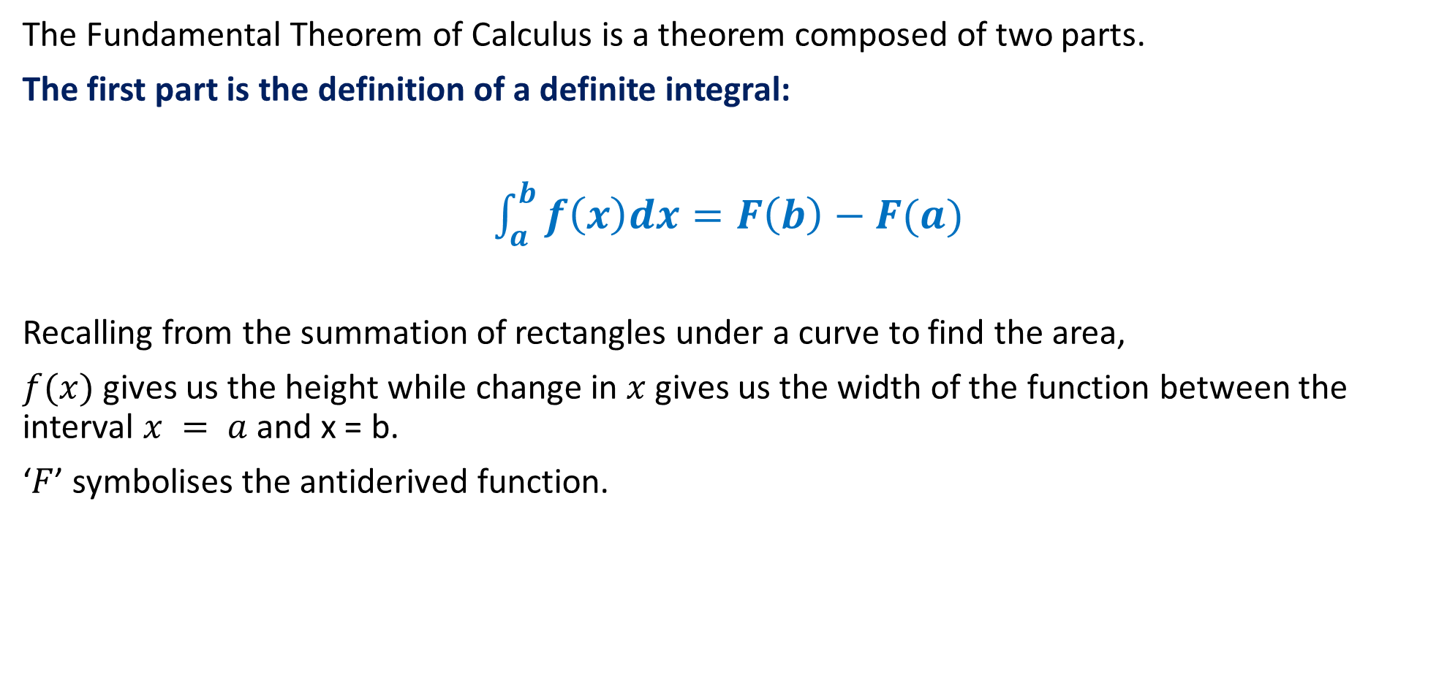
The Fundamental Theorem of Calculus
The Fundamental Theorem of Calculus is a theorem composed of two parts.
The first part is the definition of a definite integral:
$\int_{a}^{b}{f\left(x\right)dx}=F\left(b\right)−F(a)$
Recalling from the summation of rectangles under a curve to find the area,
$f(x)$gives us the height while change in $x$ gives us the width of the function between the interval $x = a$and x = b.
‘$F$’ symbolises the antiderived function.

Slide 3
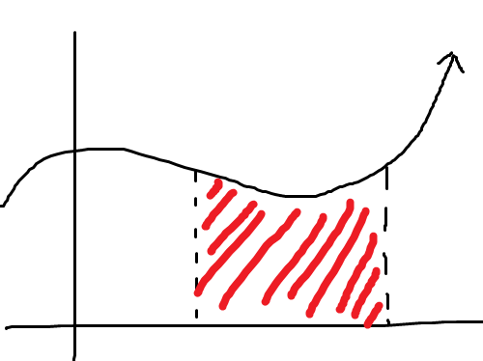
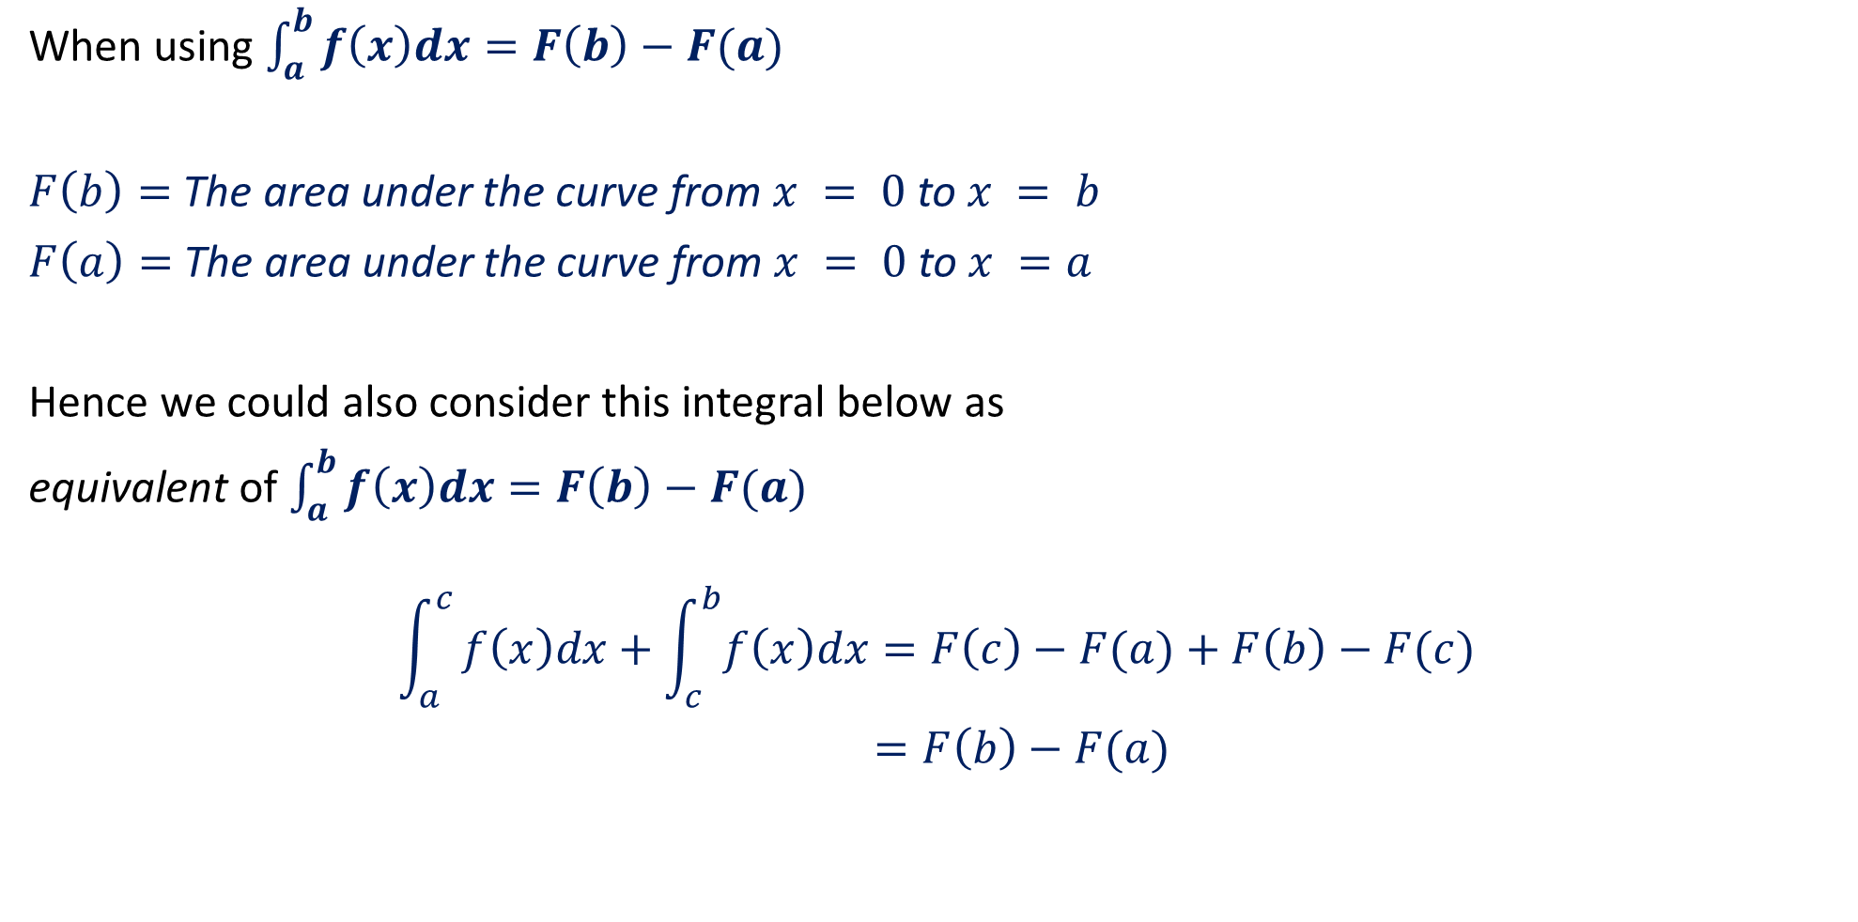
The Fundamental Theorem of Calculus
When using $\int_{a}^{b}{f\left(x\right)dx}=F\left(b\right)−F(a)$
$F\left(b\right)=$ The area under the curve from $x = 0$to $x = b$
$F\left(a\right)=$ The area under the curve from $x = 0$to $x =a$
Hence we could also consider this integral below as
equivalent of $\int_{a}^{b}{f\left(x\right)dx}=F\left(b\right)−F(a)$
$$\int_{a}^{c}{f\left(x\right)dx+\int_{c}^{b}{f\left(x\right)dx=F\left(c\right)−F(a)+F\left(b\right)−F(c)}}$$
$=F\left(b\right)−F(a)$
a
b

Slide 4

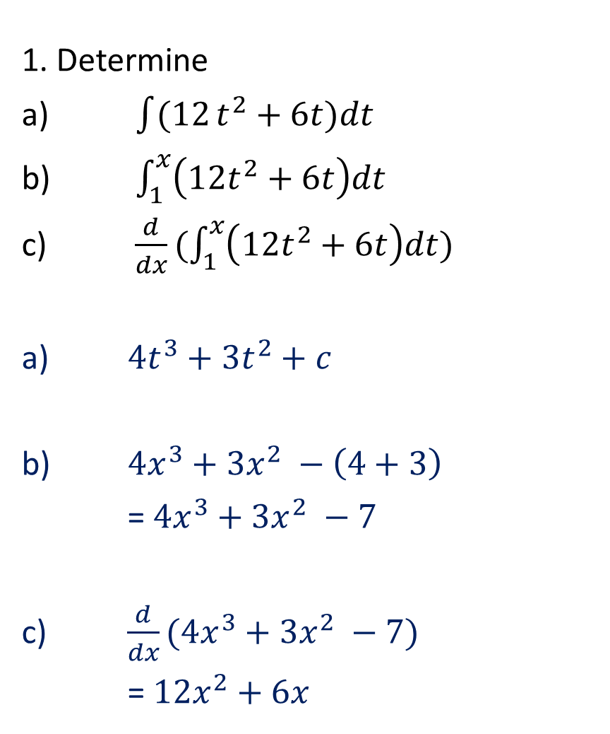
Guided Practice
1. Determine
a) $\int{(12}t^{2}+6t)dt$
b) $\int_{1}^{x}{\left(12t^{2}+6t\right)dt}$
c) $\frac{d}{dx}(\int_{1}^{x}{\left({12t}^{2}+6t\right)dt)}$
a) $4t^{3}+3t^{2}+c$
b) $4x^{3}+3x^{2} −\left(4+3\right)$
=$4x^{3}+3x^{2} −7$
c) $\frac{d}{dx}(4x^{3}+3x^{2} −7)$
= ${12x}^{2}+6x$
2. Determine
a) $\int{(1−\frac{1}{t^{2}}})dt$
b) $\int_{3}^{x}{\left(1−\frac{1}{t^{2}}\right)dt}$
c) $\frac{d}{dx}(\int_{3}^{x}{\left(1−\frac{1}{t^{2}}\right)dt)}$
a) $t+ \frac{1}{t}+c$
b) $x+ \frac{1}{x}−\left(3+\frac{1}{3}\right)$
=$x+ \frac{1}{x}−\frac{10}{3}$
c) $\frac{d}{dx}(x+ \frac{1}{x}−\frac{10}{3})$
=$1−\frac{1}{x^{2}}$

Slide 5
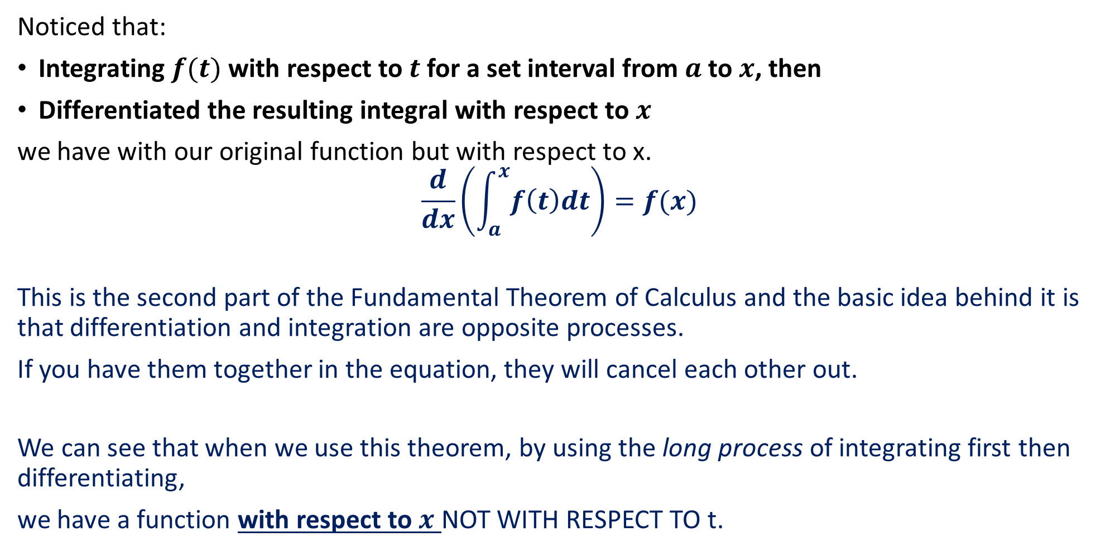
The Fundamental Theorem of Calculus
Noticed that:
Integrating $f(t)$with respect to $t$ for a set interval from $a$ to $x$, then
Differentiated the resulting integral with respect to $x$
we have with our original function but with respect to x.
$$\frac{d}{dx}\left(\int_{a}^{x}{f\left(t\right)dt}\right)=f(x)$$
This is the second part of the Fundamental Theorem of Calculus and the basic idea behind it is that differentiation and integration are opposite processes.
If you have them together in the equation, they will cancel each other out.
We can see that when we use this theorem, by using the long process of integrating first then differentiating,
we have a function with respect to $x$ NOT WITH RESPECT TO t.

Slide 6
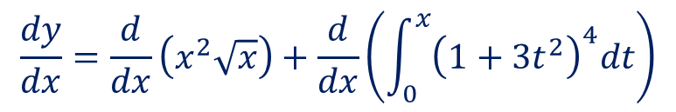
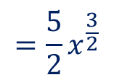

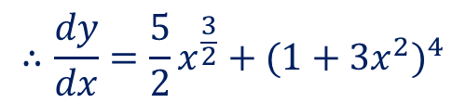
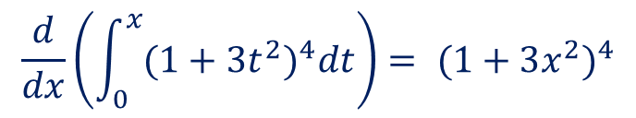
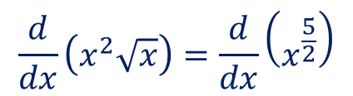
Guided Practice
By applying $\frac{d}{dx}\left(\int_{a}^{x}{f\left(t\right)dt}\right)=f(x)$ find $\frac{dy}{dx}$ given that:
$y=x^{2}\sqrt{x}+ \int_{0}^{x}{{(1+3t^{2})}^{4}dt}$
$$\frac{dy}{dx}=\frac{d}{dx}\left(x^{2}\sqrt{x}\right)+\frac{d}{dx}\left(\int_{0}^{x}{{\left(1+3t^{2}\right)}^{4}dt}\right)$$
Differentiating them separately,
$$\frac{d}{dx}\left(x^{2}\sqrt{x}\right)=\frac{d}{dx}\left(x^{\frac{5}{2}}\right)$$
$$=\frac{5}{2}x^{\frac{3}{2}}$$
$$\frac{d}{dx}\left(\int_{0}^{x}{{(1+3t^{2})}^{4}dt}\right)= {(1+3x^{2})}^{4}$$
$$∴\frac{dy}{dx}=\frac{5}{2}x^{\frac{3}{2}}+{(1+3x^{2})}^{4}$$

Slide 7

The Fundamental Theorem of Calculus
What if $x$ is the lower bound and $a$ is the upper bound? Let us use the previous example:
$\int{(12}t^{2}+6t)dt=$ $4t^{3}+3t^{2}+c$
If we invert the limits:
$$\int_{x}^{1}{\left(12t^{2}+6t\right)dt}=\left(4+3\right)−\left(4x^{3}+3x^{2}\right)$$
$$=7−3x^{2}−{4x}^{3}$$
$$={−(4x}^{3}+3x^{2} −7)$$
Notice that this is the inversion of the previous example. This means if we differentiate the integral:
$\frac{d}{dx}(\int_{x}^{1}{\left({12t}^{2}+6t\right)dt)=}\frac{d}{dx}(7−3x^{2}−{4x}^{3})$
$$=−6x−12x^{2}$$
$$=−(12x^{2}+6x)$$

Slide 8
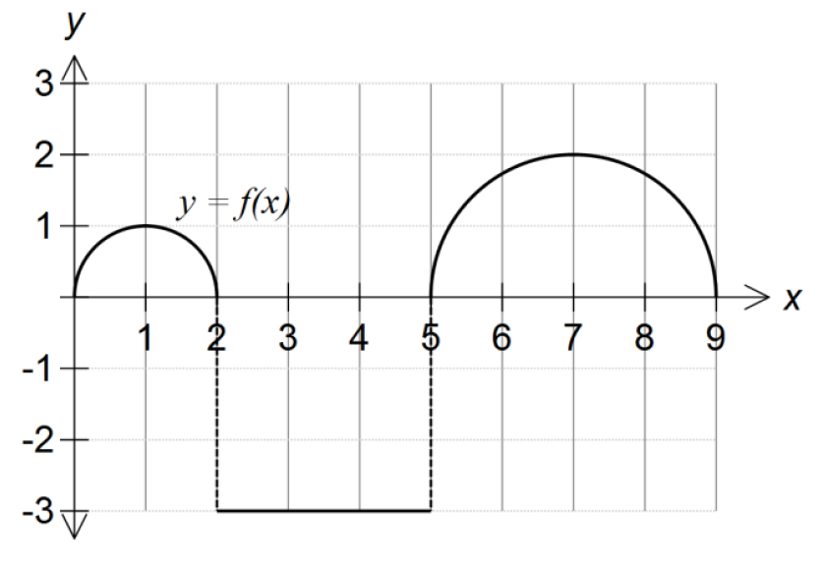

(WACE 2016 – Calc Free)
Use the graph of $y=f\left(x\right)$ to calculate
the following definite integrals:
a) $\int_{0}^{5}{f\left(x\right)dx}$
b) $\int_{0}^{9}{f\left(x\right)dx}$

Slide 9

(WACE 2016 – Calc Free)
Use the graph of $y=f\left(x\right)$ to calculate
the following definite integrals:
a) $\int_{0}^{5}{f\left(x\right)dx}$
From $x=0$ to $x=5$, we have the
area of the small semi-circle plus the
square.
$$\frac{1}{2}π{(1)}^{2}−({3)}^{2}=\frac{π}{2}−9$$

Slide 10

(WACE 2016 – Calc Free)
Use the graph of $y=f\left(x\right)$ to calculate
the following definite integrals:
b) $\int_{0}^{9}{f\left(x\right)dx}$
From $x=0$ to $x=9$, we have the
area of the small semi-circle plus the
square plus the larger semi-circle.
$$\frac{1}{2}π{(1)}^{2}−({3)}^{2}+\frac{1}{2}π{\left(2\right)}^{2}=\frac{5π}{2}−9$$

Slide 11
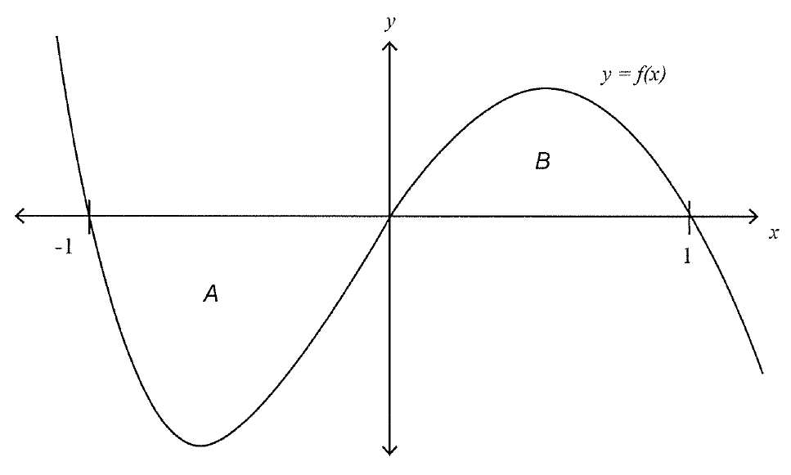

(WACE 2016 – Calc Free)
Part of the graph of $y=f(x)$ is
given to the right.
The area of the bounded
regions A and B are 7 and 4 units²
respectively.
Evaluate:
a) $\int_{0}^{1}{f\left(−x\right)dx}$
b) $\int_{−1}^{1}{\left(2−f\left(x\right)\right)dx}$

Slide 12
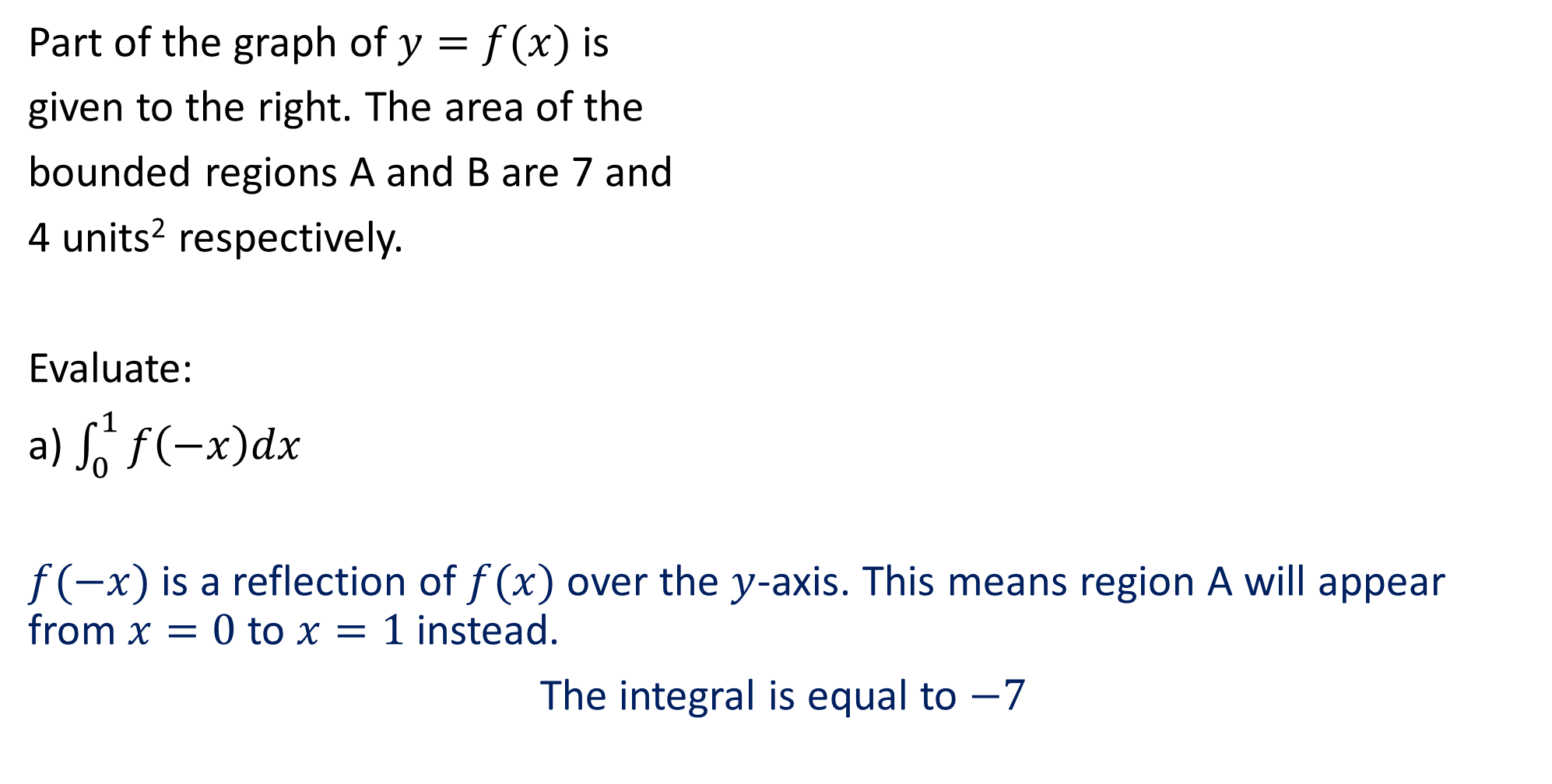
(WACE 2016 – Calc Free)
Part of the graph of $y=f(x)$ is
given to the right. The area of the
bounded regions A and B are 7 and
4 units² respectively.
Evaluate:
a) $\int_{0}^{1}{f\left(−x\right)dx}$
$f(−x)$ is a reflection of $f(x)$ over the $y$-axis. This means region A will appear from $x=0$ to $x=1$ instead.
The integral is equal to $−7$

Slide 13

(WACE 2016 – Calc Free)
The area of the
bounded regions A and B are 7 and
4 units² respectively.
Evaluate:
b) $\int_{−1}^{1}{\left(2−f\left(x\right)\right)dx}$
$$\int_{−1}^{1}{2dx}−\int_{−1}^{1}{f\left(x\right)dx}=\left(2−\left(−2\right)\right)−\left[\int_{−1}^{0}{f\left(x\right)dx}+\int_{0}^{1}{f\left(x\right)dx}\right]$$
$$=4−\left(−7+4\right)$$
The integral is equal to $7$

Slide 14
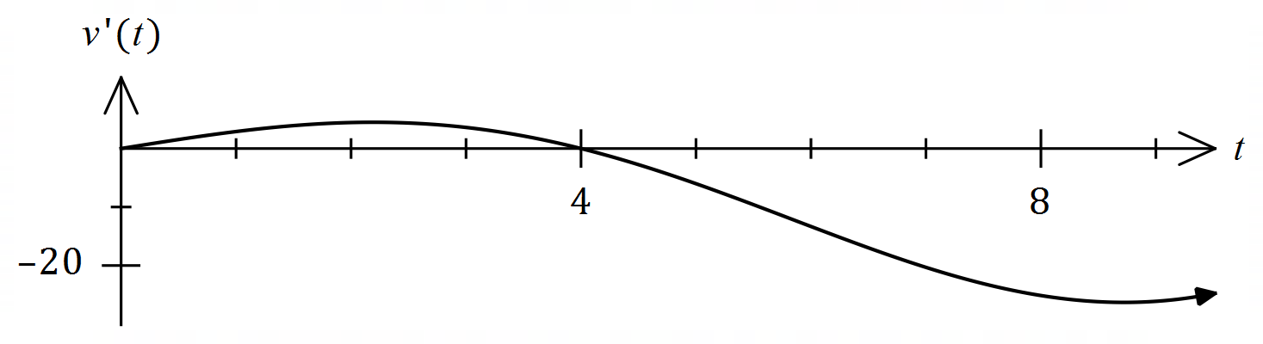
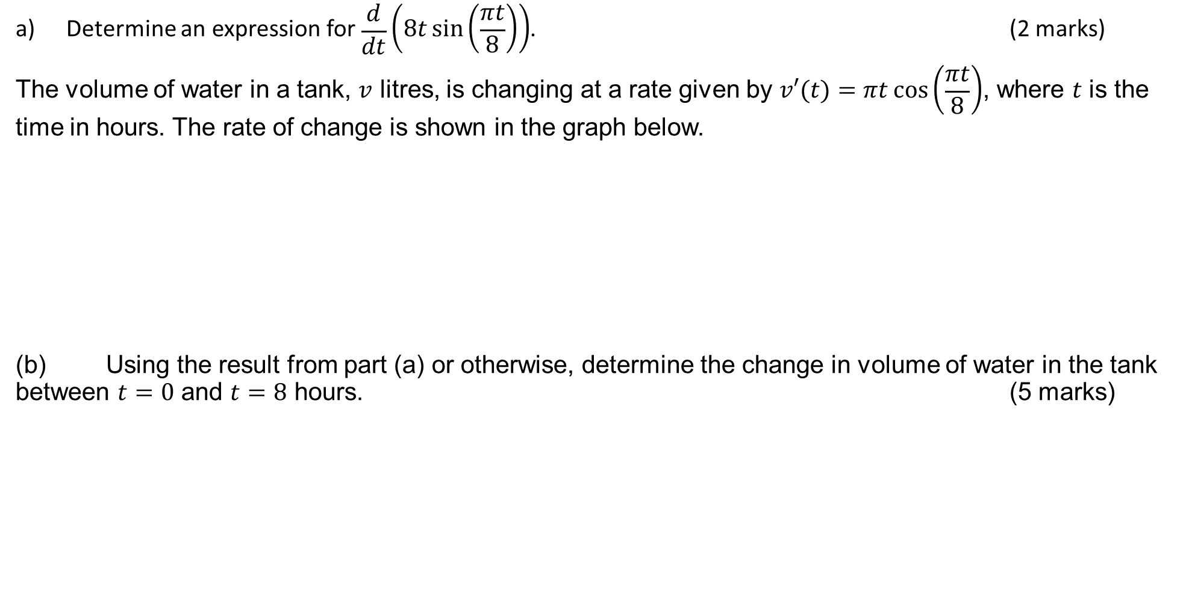
(ATAR Exam 2020 - Calc Free 7 marks)
Determine an expression for $\begin{matrix}d \\ \overline{dt}\end{matrix}\left(8t\sin\left(\begin{matrix}πt \\ \overline{ 8 }\end{matrix}\right)\right)$. (2 marks)
The volume of water in a tank, $v$ litres, is changing at a rate given by $v′(t)=πt\cos\left(\begin{matrix}πt \\ \overline{ 8 }\end{matrix}\right)$, where $t$ is the time in hours. The rate of change is shown in the graph below.
(b) Using the result from part (a) or otherwise, determine the change in volume of water in the tank between $t=0$ and $t=8$ hours. (5 marks)

Slide 15
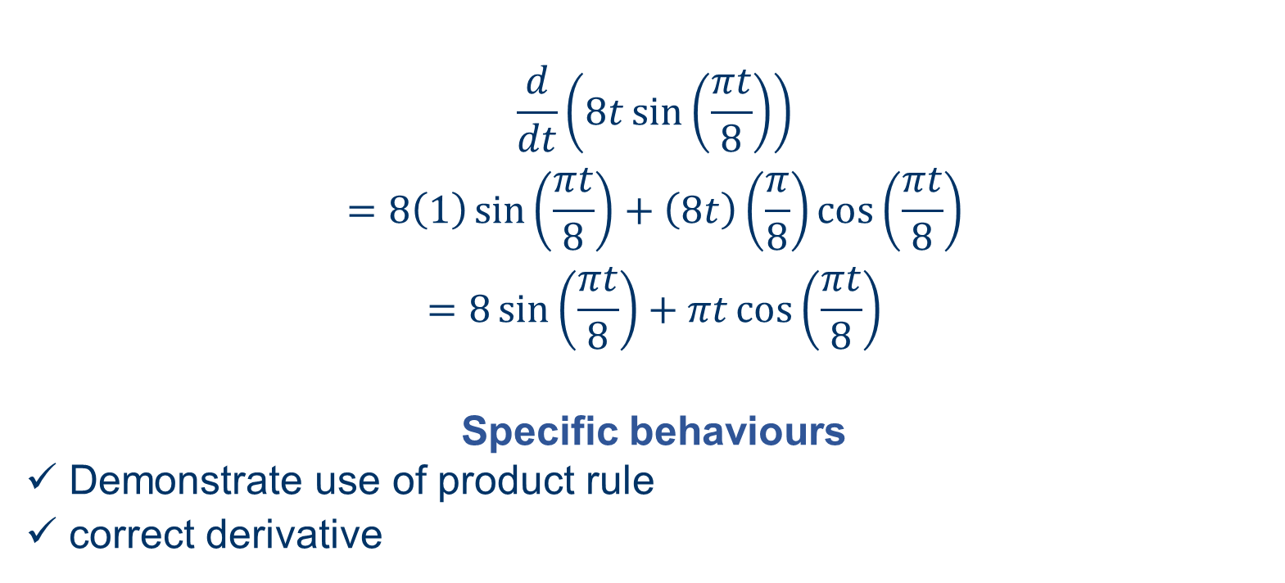
(ATAR Exam 2020 - Calc Free 7 marks)
Determine an expression for $\begin{matrix}d \\ \overline{dt}\end{matrix}\left(8t\sin\left(\begin{matrix}πt \\ \overline{ 8 }\end{matrix}\right)\right)$. (2 marks)
$$\frac{d}{dt}\left(8t\sin\left(\frac{πt}{8}\right)\right)$$
$$=8\left(1\right)\sin\left(\frac{πt}{8}\right)+\left(8t\right)\left(\frac{π}{8}\right)\cos\left(\frac{πt}{8}\right)$$
$$=8\sin\left(\frac{πt}{8}\right)+πt\cos\left(\frac{πt}{8}\right)$$
Specific behaviours
✓ Demonstrate use of product rule
ü correct derivative

Slide 16


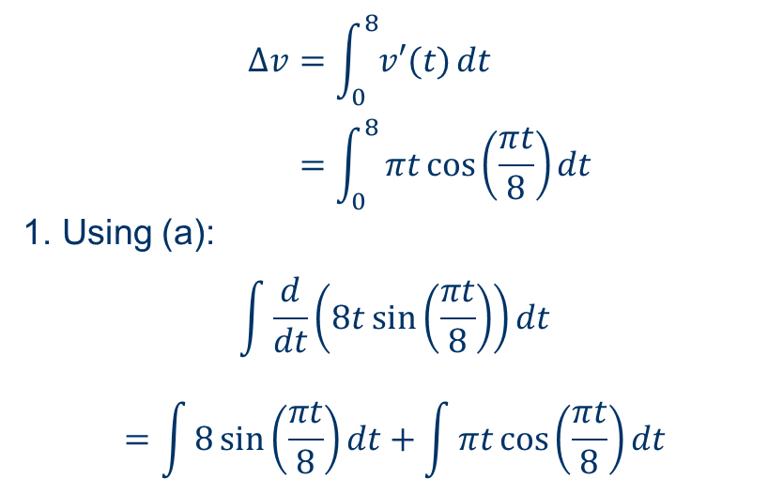
(ATAR Exam 2020 - Calc Free 7 marks)
The volume of water in a tank, $v$ litres, is changing at a rate given by $v′(t)=πt\cos\left(\begin{matrix}πt \\ \overline{ 8 }\end{matrix}\right)$, where $t$ is the time in hours. The rate of change is shown in the graph below.
(b) Using the result from part (a) or otherwise, determine the change in volume of water in the tank between $t=0$ and $t=8$ hours. (5 marks)
Specific behaviours
✓ indicates required definite integral
ü uses part (a)
ü line 2 - expression to evaluate integral
ü line 3 - antidifferentiates ready for substitution
ü correct change in volume, with units
2. And so:
$$\int{πt\cos\left(\frac{πt}{8}\right)}dt=8t\sin\left(\frac{πt}{8}\right)−\int{8\sin\left(\frac{πt}{8}\right)}dt$$
3. Hence:
$$\int_{0}^{8}{πt\cos\left(\frac{πt}{8}\right)dt}={\left[8t\sin\left(\frac{πt}{8}\right)\right]}_{0}^{8}+{\left[\frac{64}{π}\cos\left(\frac{πt}{8}\right)\right]}_{0}^{8}$$
$$=\left[0−0\right]+\left[−\frac{64}{π}−\frac{64}{π}\right]$$
$$Δv=−\frac{128}{π} \text{L}$$
$$Δv=\int_{0}^{8}{v′(t)}dt \\ =\int_{0}^{8}{πt\cos\left(\frac{πt}{8}\right)dt}$$
1. Using (a):
$$\int{\frac{d}{dt}\left(8t\sin\left(\frac{πt}{8}\right)\right)}dt$$
$$=\int{8\sin\left(\frac{πt}{8}\right)}dt+\int{πt\cos\left(\frac{πt}{8}\right)}dt$$

Slide 17
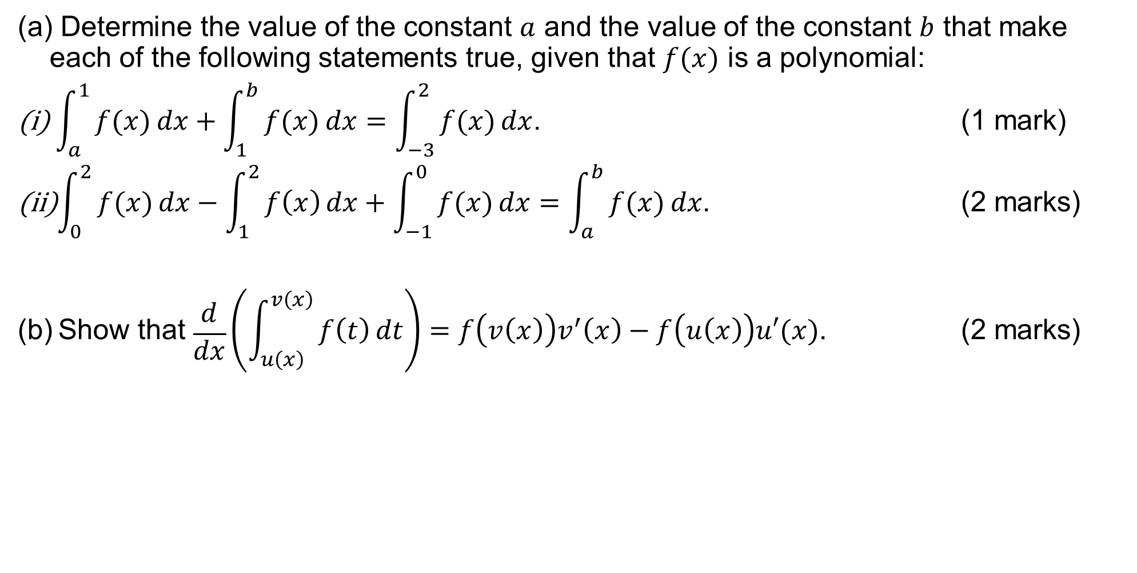
(ATAR Exam 2021 - Calc Assumed 5 marks)
Determine the value of the constant $a$ and the value of the constant $b$ that make each of the following statements true, given that $f(x)$ is a polynomial:
$\int_{a}^{1}{\underset{ }{\overset{ }{f(x)}}}dx+\int_{1}^{b}{\underset{ }{\overset{ }{f(x)}}}dx=\int_{−3}^{2}{\underset{ }{\overset{ }{f(x)}}}dx$. (1 mark)
$\int_{0}^{2}{\underset{ }{\overset{ }{f(x)}}}dx−\int_{1}^{2}{\underset{ }{\overset{ }{f\left(x\right)}}}dx+\int_{−1}^{0}{\underset{ }{\overset{ }{f(x)}}}dx=\int_{a}^{b}{\underset{ }{\overset{ }{f(x)}}}dx$. (2 marks)
(b) Show that $\begin{matrix}d \\ \overline{dx}\end{matrix}\left(\int_{u\left(x\right)}^{v\left(x\right)}{\underset{}{\overset{ }{f\left(t\right)}}}dt\right)=f\left(v\left(x\right)\right)v^{′}\left(x\right)−f\left(u\left(x\right)\right)u′(x)$. (2 marks)

Slide 18
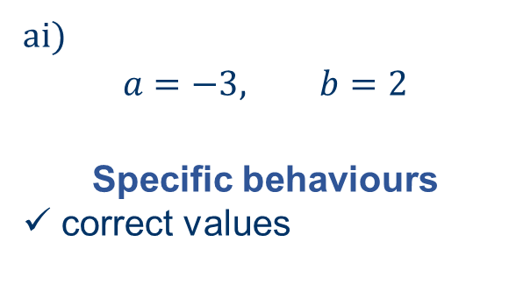
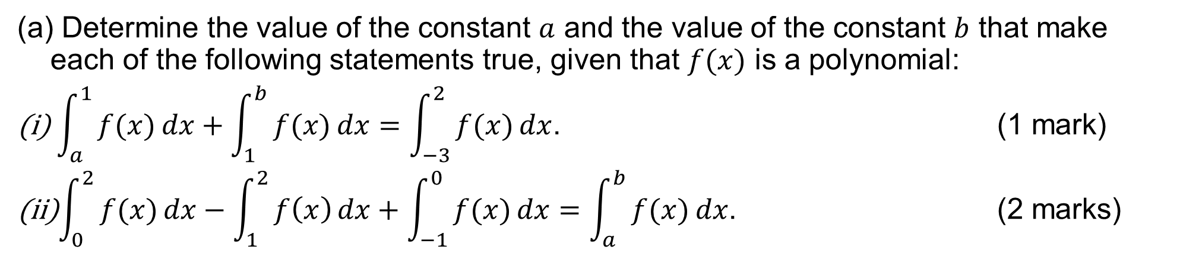
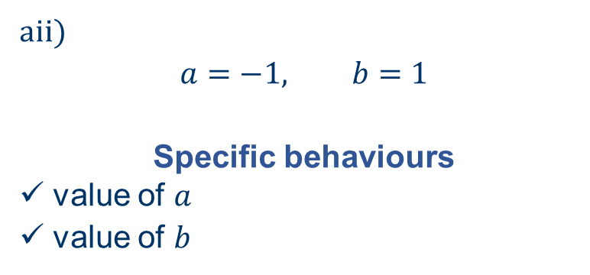
(ATAR Exam 2021 - Calc Assumed 5 marks)
Determine the value of the constant $a$ and the value of the constant $b$ that make each of the following statements true, given that $f(x)$ is a polynomial:
$\int_{a}^{1}{\underset{ }{\overset{ }{f(x)}}}dx+\int_{1}^{b}{\underset{ }{\overset{ }{f(x)}}}dx=\int_{−3}^{2}{\underset{ }{\overset{ }{f(x)}}}dx$. (1 mark)
$\int_{0}^{2}{\underset{ }{\overset{ }{f(x)}}}dx−\int_{1}^{2}{\underset{ }{\overset{ }{f\left(x\right)}}}dx+\int_{−1}^{0}{\underset{ }{\overset{ }{f(x)}}}dx=\int_{a}^{b}{\underset{ }{\overset{ }{f(x)}}}dx$. (2 marks)
ai)
$$a=−3, b=2$$
Specific behaviours
✓ correct values
aii)
$$a=−1, b=1$$
Specific behaviours
✓ value of $a$
ü value of $b$

Slide 19
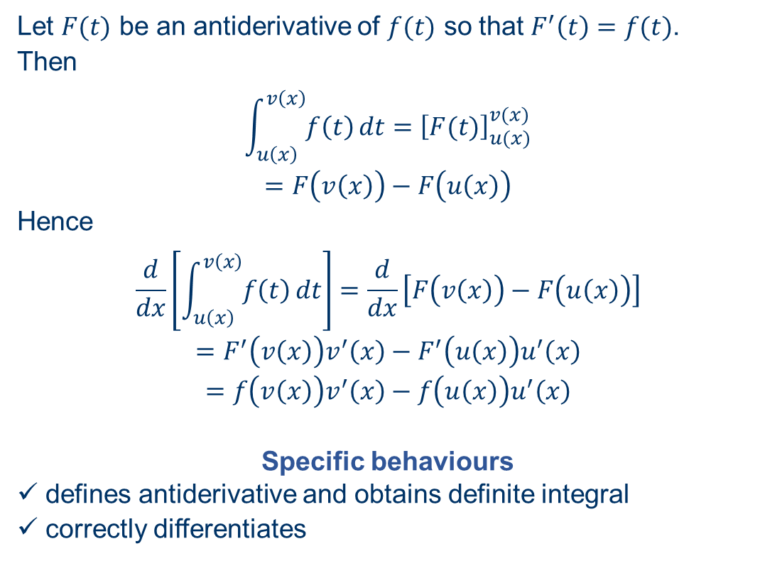
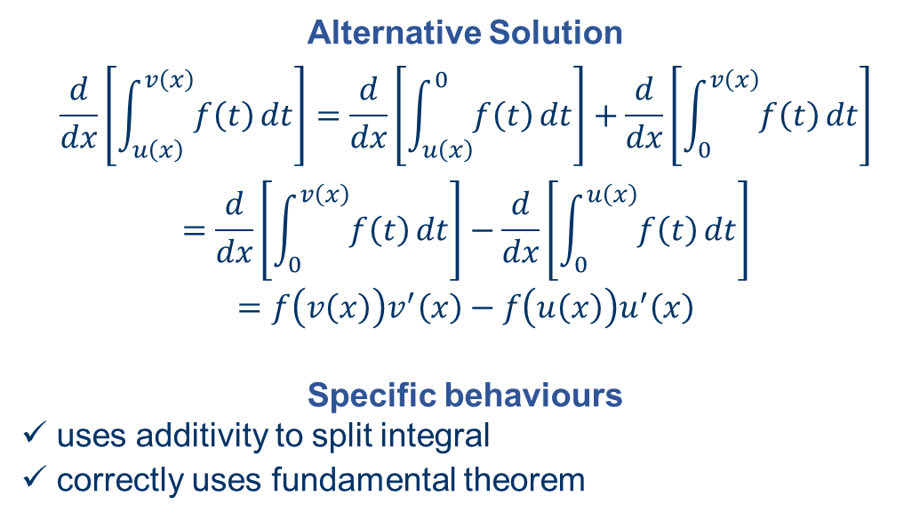
(ATAR Exam 2021 - Calc Assumed 5 marks)
(b) Show that $\begin{matrix}d \\ \overline{dx}\end{matrix}\left(\int_{u\left(x\right)}^{v\left(x\right)}{\underset{}{\overset{ }{f\left(t\right)}}}dt\right)=f\left(v\left(x\right)\right)v^{′}\left(x\right)−f\left(u\left(x\right)\right)u′(x)$. (2 marks)
Let $F(t)$ be an antiderivative of $f(t)$ so that $F^{′}\left(t\right)=f(t)$.
Then
$$\int_{u\left(x\right)}^{v\left(x\right)}{f\left(t\right)}dt={\left[F(t)\right]}_{u(x)}^{v(x)}$$
$$=F\left(v\left(x\right)\right)−F\left(u\left(x\right)\right)$$
Hence
$$\frac{d}{dx}\left[\int_{u\left(x\right)}^{v\left(x\right)}{f\left(t\right)}dt\right]=\frac{d}{dx}\left[F\left(v\left(x\right)\right)−F\left(u\left(x\right)\right)\right]$$
$$=F^{′}\left(v\left(x\right)\right)v^{′}\left(x\right)−F^{′}\left(u\left(x\right)\right)u^{′}\left(x\right)$$
$$=f\left(v\left(x\right)\right)v^{′}\left(x\right)−f\left(u\left(x\right)\right)u^{′}\left(x\right)$$
Specific behaviours
✓ defines antiderivative and obtains definite integral
ü correctly differentiates
Alternative Solution
$$\frac{d}{dx}\left[\int_{u\left(x\right)}^{v\left(x\right)}{f\left(t\right)}dt\right]=\frac{d}{dx}\left[\int_{u\left(x\right)}^{0}{f\left(t\right)}dt\right]+\frac{d}{dx}\left[\int_{0}^{v\left(x\right)}{f\left(t\right)}dt\right]$$
$$=\frac{d}{dx}\left[\int_{0}^{v\left(x\right)}{f\left(t\right)}dt\right]−\frac{d}{dx}\left[\int_{0}^{u\left(x\right)}{f\left(t\right)}dt\right]$$
$$=f\left(v\left(x\right)\right)v^{′}\left(x\right)−f\left(u\left(x\right)\right)u^{′}\left(x\right)$$
Specific behaviours
✓ uses additivity to split integral
ü correctly uses fundamental theorem

Slide 20
Independent Practice
Complete Cambridge Ex 6K
Extra Worksheet from JKLUP

